Slide 1

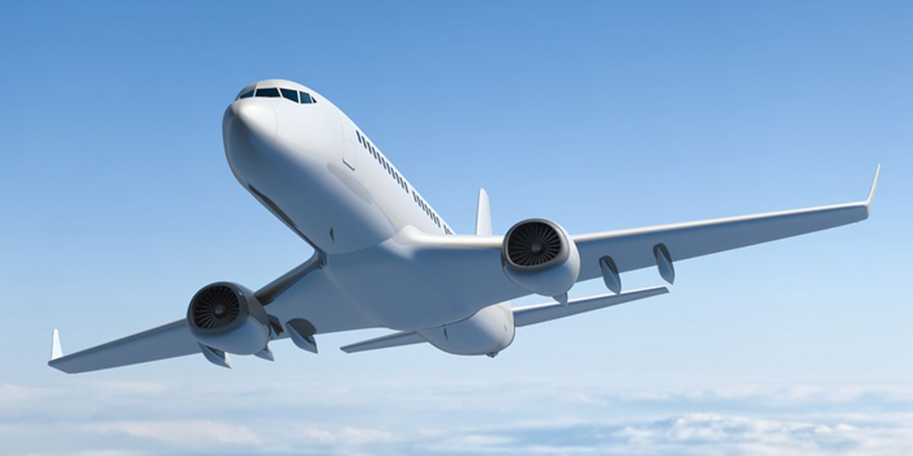
SAFETY IN THE AIRLINE INDUSTRY
Kyle morris
Notes:
Hello, my name is Kyle Morris and I’m here to talk to you today about safety in the airline industry. There are some flight names that are burned in to our collective consciousness. US Airways Flight 1549. Lion Air Flight 610, and Ethiopian Airlines Flight 302. Oceanic Airlines Flight 815. There’s a chance you may have recognized a few of these, unlike the names of the nearly 100,000 flights that take off on a normal day, pre-COVID-19. Those would be Captain Sully's Miracle on the Hudson, the two fatal flights that grounded the Boeing 737-MAX, and the flight from LOST, respectively.
With such well-publicized incidents, both fatal, fictional, or miraculous, you might get the impression that these days, you are taking your life into your own hands every time you risk flying rather than driving, boating, or even walking! After all, you might say, hopping into a metal tube cruising at 583 MPH at 35,000 feet is just asking for trouble!
This could not be farther from the truth!

Slide 2
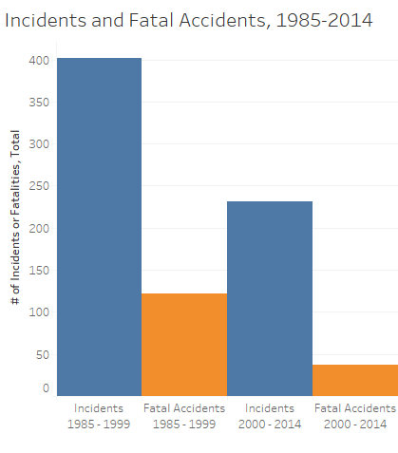

Notes:
For many years now air travel has been one of the safest modes of transportation available to the traveler. The airline industry has been totally committed to safety for decades, and in the United States it has operated at an unprecedented level of safety. “During the past 20 years, commercial aviation fatalities in the U.S. have decreased by 95 percent as measured by fatalities per 100 million passengers.”
We can look at the raw numbers to see this for ourselves. Here we can compare the incidents and fatal incidents over two time periods, from 1985-1999 and from 2000 - 2014. As you can see, not only has the number of incidents declined 57% over the two time periods, but 30% of incidents were fatal in the first time frame compared to 16% in the second. Not only are you less likely to be involved in an incident these days, being in an incident is far less likely to be fatal than it was previously.

Slide 3
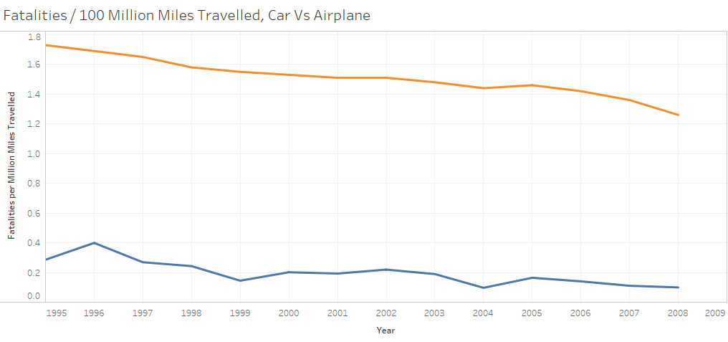

Relative Safety, Motor Vehicle versus Airplane
In 2008, you were 12.66 times more likely to die in a passenger vehicle than an airplane per mile travelled.
Notes:
You might be asking yourself, sure, it looks like I’m less likely to be injured, but I’m going to be sticking to driving. At least then, I’m in control of the vehicle and it will just take us longer to get there. The fact is, nearly 38,000 people died in car crashes in 2016 alone[*] versus the 18,627 people that died because of aircraft-related incidents from 1995 – 2008. As you can see, per 100 million miles traveled, traveling by car can be far more dangerous than traveling by airplane. In 2008, the most recent year available in our dataset, you were 12.66 times more likely to die traveling by car than by airplane. Until we have self-driving cars, this trend will likely continue (and even then, who is to say that self-driving technology will not be integrated into aircraft systems as well, further plummeting the incident rate for the airline industry?)

Slide 4
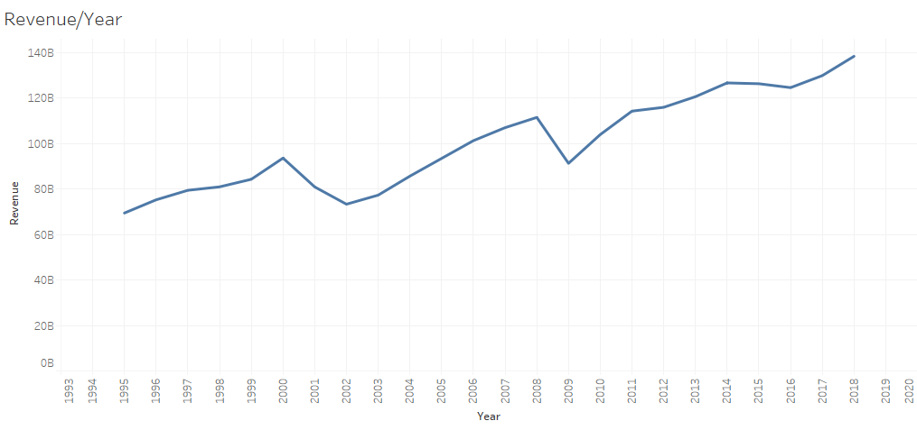

Airline Industry Revenue by Year, Global
Global flights have increased since 1995.
Slight downturns in the wake of 9/11 and the 2009 global recession have done little to deter the public from flying.
COVID-19 will absolutely influence revenue, but the industry has recovered quickly in the past.
Notes:
If the number of flights have decreased over the years, the number of incidents would have decreased at a similar rate. However, the airline industry is bigger than ever. If planes had become more dangerous (or even the same rate of incidents), we would expect the number of incidents to increase. However, despite an increase in flights, we have seen a decrease in incidents.

Slide 5
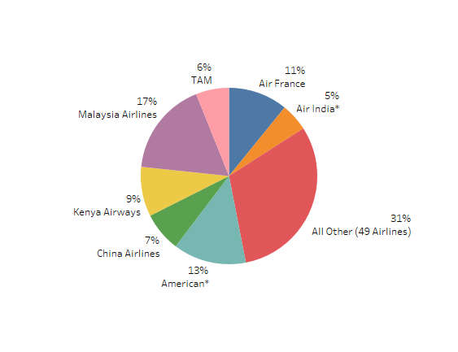

Percent Fatalities by Airline, 2000 - 2014
7 airlines were responsible for 69% of the overall fatalities, with the remaining 49 airlines responsible for 31%.
Overall, there were 6295 deaths in the older time frame compared to 3109 in the newer one.
Notes:
The carrier you choose to fly with can influence your chances of having an accident. Over the 2000-2014 time period, just 7 carriers were responsible for 69% of the overall deaths. The remaining 31%? Split between 49 additional carriers. A small number of carriers are responsible for most plane-related deaths.

Slide 6

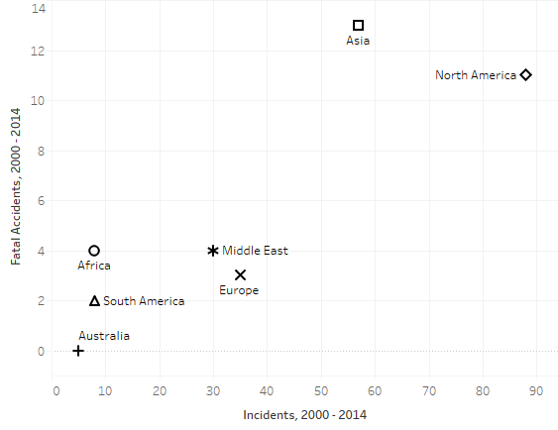
Fatal and Total Incidents, by Region
50% of incidents involving Africa-based carriers were fatal.
Despite having the most incidents, North American carriers had the third lowest percentage of fatal accidents, 12.5%.
22.8% of incidents involving Asian carriers were fatal.
Australian carriers had a 0% fatality rate, but the least data points – only 5 incidents.
Notes:
Even the section of the world can have an effect. Here, we can see the number of accidents by each region of the world, compared to how many of those accidents involved deaths. While North America has the most fatal incidents and incidents, their ratio is one of the lowest!

Slide 7
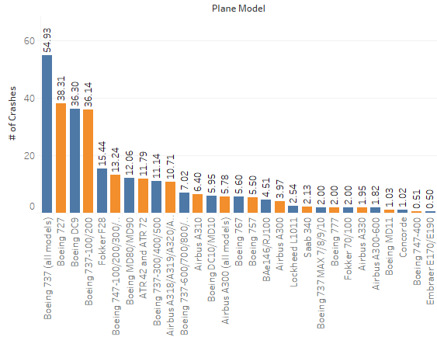

Plane Crashes by Model
Boeing 737 had the most crashes, but on a crash/mile flown basis was in the top third of safe flights.
The Boeing 737 Max had the second highest after the Concorde, with 2 crashes after 650,000 flights.
The Boeing 737-600/700/800/900, for comparison, had 11 events in 110.3 million flights.
Notes:
Finally, we can see here that some models have better track records than others. In the entire life of the Boeing 737, there have been about 55 crashes. Now, this plane has logged billions of miles with only a few dozen crashes to show for it. Meanwhile, the Boeing 737 Max had 2 crashes after just 650,000 flights. The Boeing 737 would still need about 15 times as many flights as the 737 Max before it would see its first one. It shows just how troubled that plane is.

Slide 8
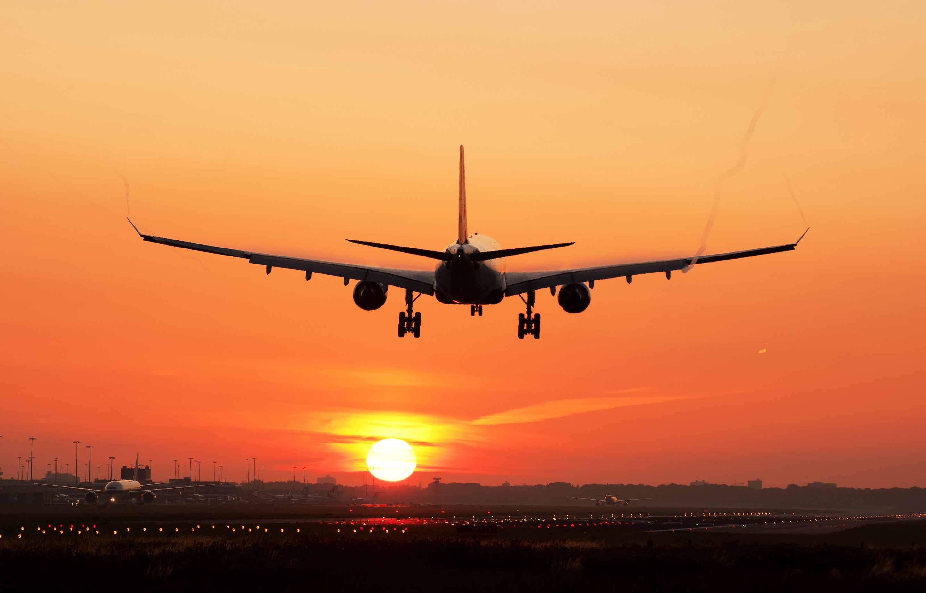

Summary
Despite the picture painted by the media, airplane travel is safer than it has been in years.
The economic downturn will have an extreme effect on the industry, but even 9/11 and the Great Recession proved to be minor blips.
People are travelling far more often they had in the past, and a seismic shift like travel habits are unlikely to be permanent changes.
Safety incidents are on the decline and confined to a handful of carriers.
Airplanes remain one of the safest ways to travel
Notes:
In today’s 24/7 news cycle, big incidents steal a lot of press time. In addition, reporting of incidents has become mandatory and the fact is that we have a lot more data at our fingertips then we used to. In years past, a plane crash in Asia might only make a blip in the world news section of your local paper unless a hometown hero was involved. But now, it will be front-page news across the internet. That is not necessarily a bad thing, but it is important to have some perspective.
Looking at the underlying data, it is clear to see that air travel is safer than it has ever been, especially compared to the alternatives. So if you are worried about traveling by air, relax! Put your tray table up, return your seat to its full upright locked position and we will see you at 35,000 feet!

Slide 9



Thank You
Kyle Morris
kymorris@my365.Bellevue.edu
https://github.com/jkylemorris/DSC640

Slide 10
Sources
Airline Safety - Airline Data Project
Transportation Data - NHTSA
Plane Incidents by Model - AirSafe.com
Plane Crashes, Global - Data.World, by way of Kaggle

